Slide 1
SMART FARMER- Iot Based Smart Farming Application TEAM ID:PNT2022TMID21246
SUBMITTED BY
19C001_ABIRAMIPRIYA J
19C040_KALAISELVI S
19C042_KAVIYA D
19C048_LAVANYA R

Slide 2
ABSTRACT
The history of agriculture began thousands of years ago. After gathering wild grains beginning at least 105,000 years ago, nascent farmers began to plant them around 11,500 years ago. Agriculture is the practice of cultivating plants and livestock.
Agriculture was the key development in the rise of sedentary human civilization, whereby farming of domesticated species created food surpluses that enabled people to live in cities.
Modern agronomy, plant breeding, agrochemicals such as pesticides and fertilizers, and technological developments have sharply increased crop yields, but cause ecological and environmental damage.
AGRICULTURE IS THE BACKBONE OF INDIAN ECONOMY

Slide 3
INTRODUCTION
Agriculture is the practice of cultivating natural resources to sustain human life and provide economic gain. It combines the creativity, imagination, and skill involved in planting crops and raising animals with modern production methods and new technologies.
Agriculture is also a business that provides the global economy with commodities: basic goods used in commerce, such as grain, livestock, dairy, fiber, and raw materials for fuel.
Even though many modern approaches takes place to make an effective agriculture practice. There are still problems that are faced by farmers in their daily life such as, unpredictable climate changes, adapting new technology, and monitoring each and every work about their agricultural land.
Farming is a complex, unpredictable and individual business.

Slide 4
PROBLEM STATEMENT
OUR PROBLEM STATEMENT IS
TO REDUCE MANUAL WORKS OF A FARMER BY MONITORING AND CONTROLLING THE AGRICULTURAL LANDS

Slide 5
OBJECTIVES
The main objective of the project is to monitor the
Temperature level of the agricultural land
Humidity of the plants
Moisture level of the soil
Irrigation control of the agricultural land

Slide 6
LITERATURE SURVEY
S.NO | PAPER TITLE | AUTHOR NAME | PUBLICATION YEAR | RESULTS
1. | Machine learning applications in IoT based agriculture and smart farming | MWP Maduranga, Ruvan Abeysekera | 2020 | To improve productivity of agriculture through intelligent farm management, the data analysing must be well analysed and processed. High-performance computing capability in ML opens up new opportunities for data-intensive science as the amount of data collected increases; In this article we review existing approaches have been made to the smart agriculture and farming based on IoT and ML separately. Also, we propose novel concepts that how can ML-IoT can be blended in such applications.

Slide 7
S.NO | PAPER TITLE | AUTHOR NAME | PUBLICATION YEAR | RESULTS
2 | A Survey on the Role of IoT in Agriculture for the Implementation of Smart Farming | Muhammad Shoaib Farooq, Shamyla Riaz, Adnan Abid, Kamran Abid, Muhammad Azhar Naeem | 2019 | A sensor performs multiple tasks like soil sensing, temperature sensing, weather sensing, light sensing, and moisture sensing. Similarly, devices perform many control functions like, node discovery, device identification and naming services etc. All these functions are performed by any device or sensor which is controlled through a microcontroller.

Slide 8
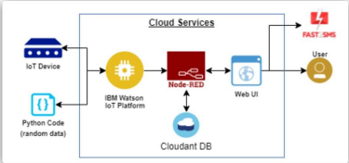
SOLUTION ARCHITECTURE

Slide 9
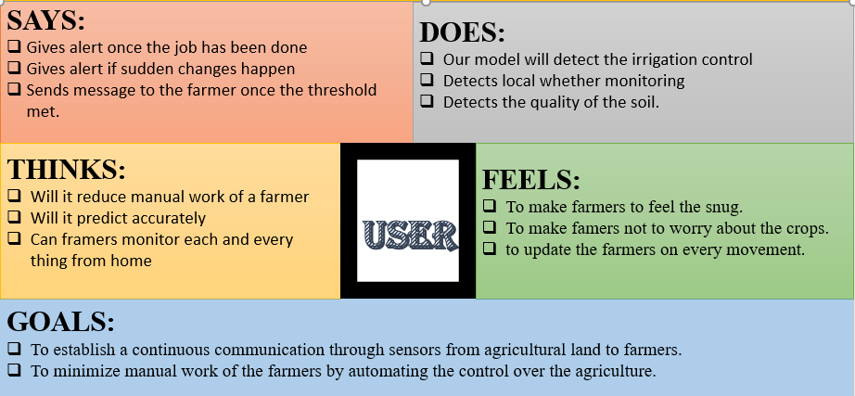
HOW USER FEELS

Slide 10
PROPOSED SOLUTION
S.NO | PARAMETER | DESCRIPTION
1 | SOLUTION DESCRIPTION | Our solution for smart farming system includes Our system includes a humidity sensor and moisture sensor to detect the current soil conditions and to know whether there are any deviations from the pre-determined threshold. If a particular threshold is met in the water level, then the servo motor is automatically ON or OFF. Notifications regarding the soil conditions and the moisture level will be sent to the farmer using MIT app inventor.
2 | SCALABLITY OF THE SOLUTION | The solution can be easily expandable to larger fields by deploying sensors wherever needed. The values would be read and based on the threshold, warnings and notifications could be given to the farmer. ❖ By using GSM modules, the farmer gets notifications quickly and the automation can also be done without any manual interruption.

Slide 11
S.NO | PARAMETER | DESCRIPTION
3 | NOVELTY/UNIQUENESS | Preceding system’s objectives: In the prior systems, the main objective is to switch on or off the servo motor based on the pre-determined threshold. The farmer will not be able to know about what is happening in the field. Proposed system’s objective: We will be designing a system in which the notifications regarding the water level and the soil conditions will be sent to the farmer directly using blink app.
4 | CUSTOMER SATISFICATION | The main objectives of this proposed solution are ❖ User-friendly – Easy access for the farmer with the help of notifications. ❖ Flexible – Check status of the water level and soil conditions under all the conditions.

Slide 12
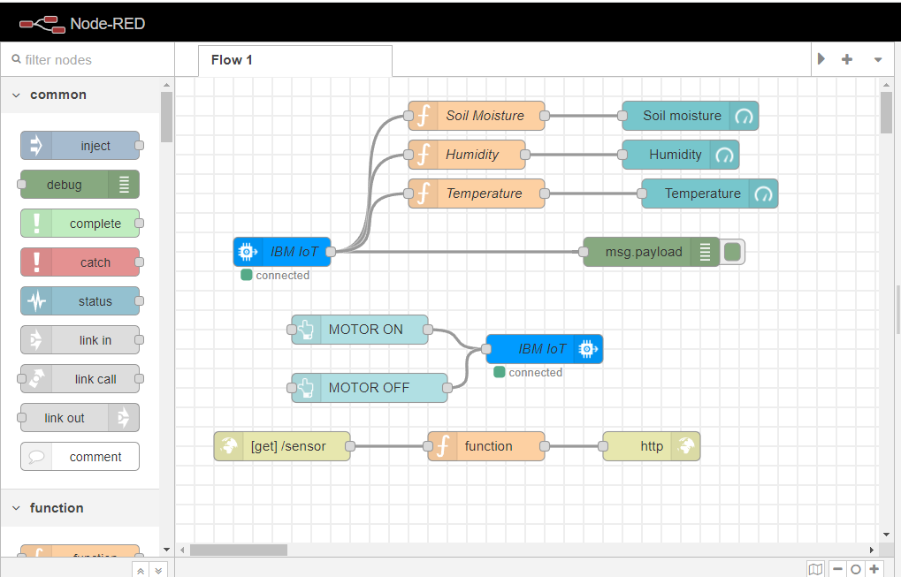
IMPLEMENTATION
NODE RED EDITOR

Slide 13
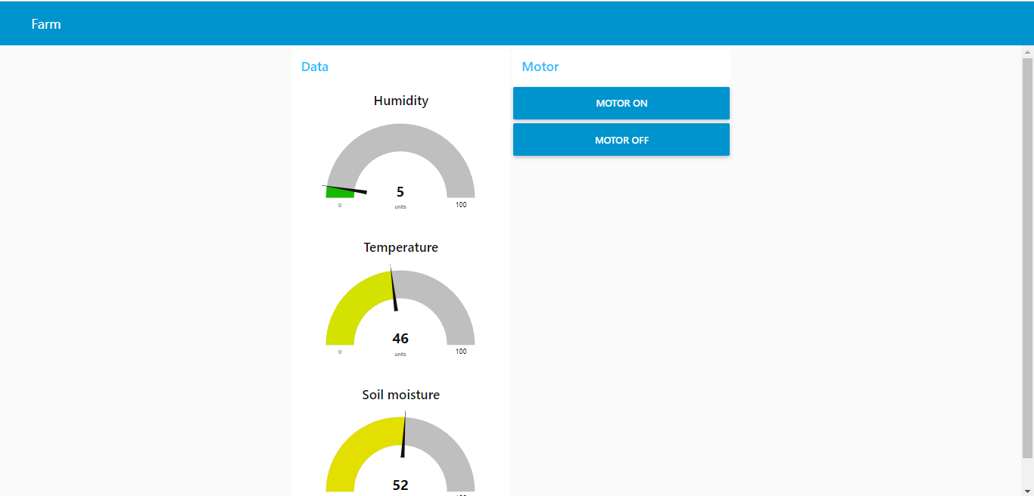
NODE RED DASHBOARD
NODE RED DASHBOARD FOR DISPLAYING THE RESULTS

Slide 14
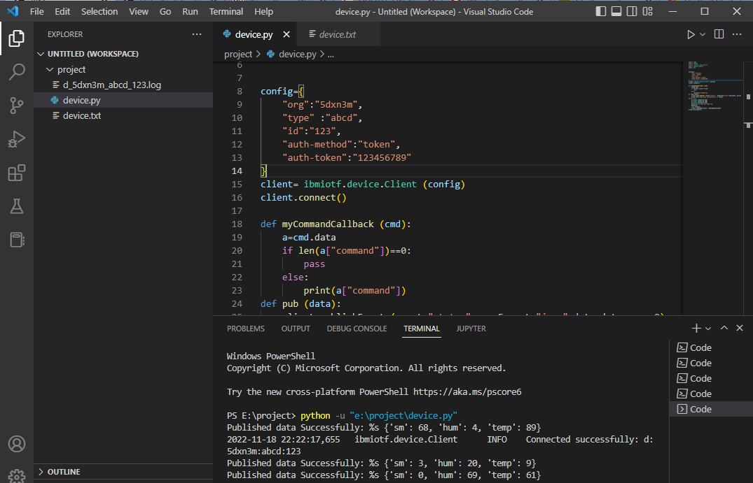
IMPLEMENTATION(CODE)
DISPLAYING RANDOM DATA USING PYTHON

Slide 15
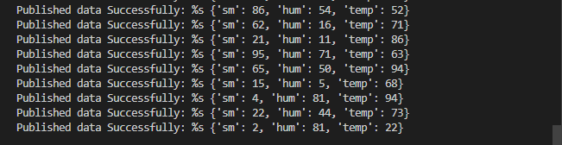
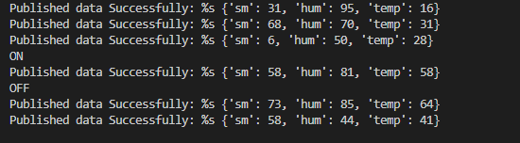
REFLECTION OF MOTOR OPERATION BY FARMER AND DISPLAYING THE OUTPUT VALUES

Slide 16
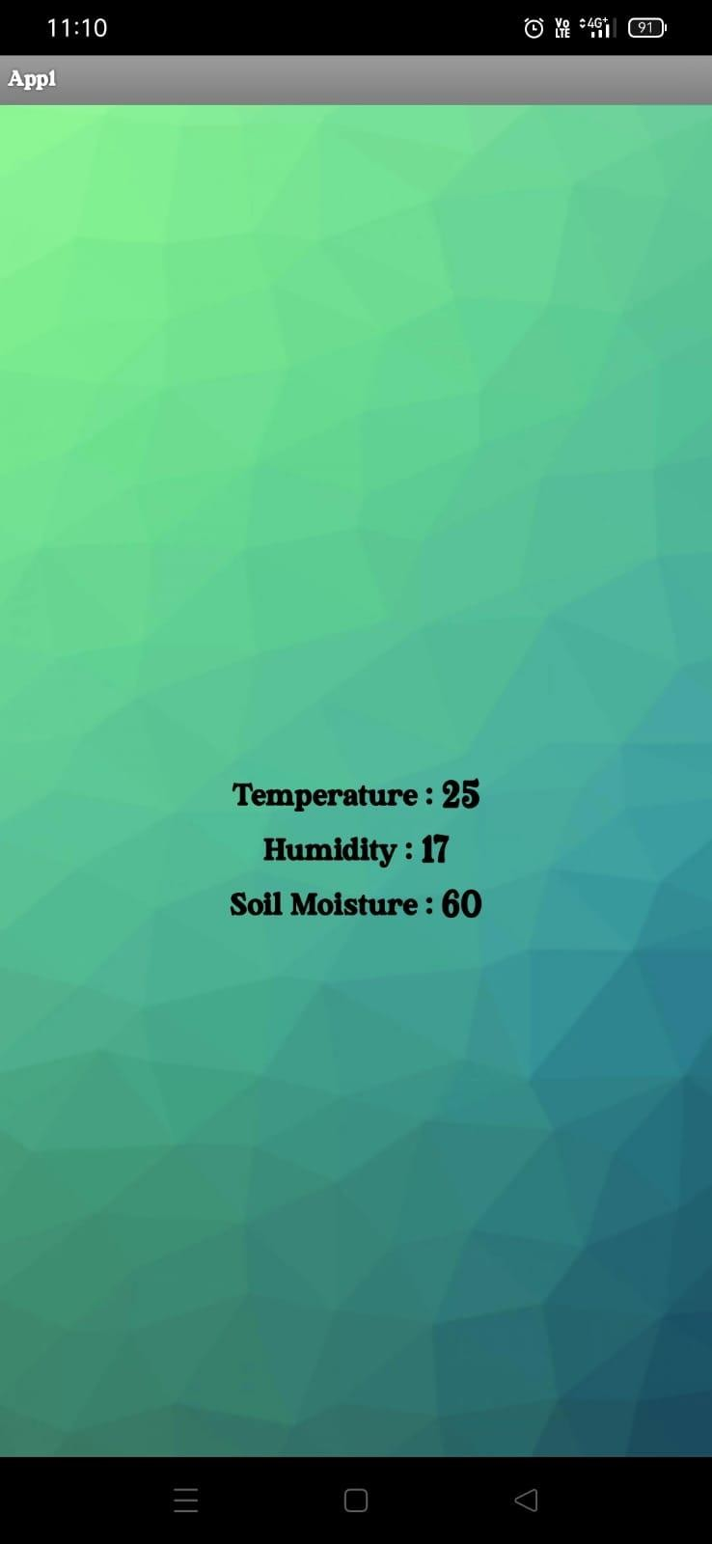
VISUALIZING THE RESULTS USING MOBILE APP
DISPLAYING THE DATA TO THE FARMERS USING MIT APP INVENTOR

Slide 17
CONCLUSION
The device will store the value of the temperature level of the agricultural land, moisture level of the soil and humidity of the plants.
By using this device, the farmer can be able to monitor the agricultural land without any manual work or without any physical presence.
The motor can be operated by the farmer without any physical presence.
This model will reduce the physical work of the farmer so that the farmer can monitor without any location constraints.
Our proposed solution will send the data to the farmer through their mobile application and the farmer can control the irrigation control from home itself.
AGRICULTURE IS NOT JUST A FARMING, IT’S A FEEDING
SO IF YOU ARE EATING TODAY, THANK A FARMER

Slide 18
